Slide 1
Myology
Gross Anatomy
Dr. Firas A. Alhasson
University of Basrah
Anatomy and Histology Department
Veterinary Medicine College
Notes:
1

Slide 2
MYOLOGY: GENERAL
Muscle is derived from the term “mus” or “mys” for mouse.
Myology – movement of muscles, characteristics of all organisms
Main role of muscles is a device that converts the chemical energy of ATP (adenosine triphosphate) into mechanical energy of movement.
Notes:
2
Technically each one is an organ - it is composed of skeletal muscle tissue, c.t., and nervous tissue.

Slide 3
MYOLOGY: GENERAL
Muscle is a specialized connective tissue
It contracts (contractile units) to produce body movement in response to nerves or (humoral) hormones stimulation.

Slide 4
THE FUNCTIONS OF MUSCLES
Muscles provide motive power for:
Locomotion [movement] &
Movements of body contents
Respiration (diaphragm & intercostal)
Circulation
Alimentation (digestion – GI tract, defecation, & urination. Movement of body contents)
Child birth
Indication of emotional states
Barking, facial expression (cutaneous muscles), raising hair, or waging tail

Slide 5
MYOLOGY: GENERAL
Muscle fiber- Myocyte (organelles, fibers etc.) and Sarcomeres
Components:
Protein fibers 🡪 actin & Myosin
Microfilaments
Glycogen
Deposit of myelin &

Slide 6
MYOLOGY: GENERAL
Fascia is a sheet or band of fibrous connective tissue
Attaching skin to underlying tissues
Invests muscles, tendons, ligaments and certain organs
Notes:
15

Slide 7
TYPES OF FASCIA
Superficial fascia (subcutis) or (areolar)
Below the skin
Principal sites for the storage of fat
S/C injections are made into this tissue
Deep fascia
Tougher fibrous sheets
Fuses to bones
Penetrates between muscles,
Assists return of blood and lymph to heart (contraction of muscle pushes blood back)
Notes:
Injections (Also can use intravenous, intramuscular, oral cavity, intraperitoneal,
More fiber than muscle. Like carotid sheaths

Slide 8
MYOLOGY: FUNCTIONS OF FASCIA
Attachment of skin and muscles
Pathway for vessels and nerves
Containing sheaths for muscles to operate
Binds down and redirects tendon forces
Fat storage
It is encountered in surgery
Direction of spreading fluids and pus
Holds sutures securely in wound closure
Notes:
16

Slide 9
MYOLOGY: GENERAL
Muscle is grouped into one of three types:
Smooth muscle
Cardiac muscle
Skeletal muscle
Voluntary (usually subject to conscious control)
Striated
Diaphragm and cremaster don’t under control its skeletal muscles
Notes:
Homeostasis in anatomy
Intestine , bladder , …..

Slide 10
SKELETAL MUSCLE
~ 50% of the body is the carcass
All attached to bone
Not limited to the skeleton.
Found in the pharynx, esophagus, & skin
(ie.. cutaneous trunci).

Slide 11
SKELETAL MUSCLE
Functions:
1. Movements of animal body
Prevent unwanted movements (stabilizing joints)
Movement: most obvious function is to move the body, as in walking, running, writing, chewing, and swallowing. Stimulation maintains a state of muscle contraction “tonus” for movement of blood & lymph.
Posture: Skeletal muscles maintain posture by stabilizing the flexible muscles.
2. Control of body openings and passages “maintain continence”:
Ring-like sphincter muscles
(eyelids, pupils, mouth, urethra , & anus)

Slide 12
SKELETAL MUSCLE
Functions (cont.):
3. Generate heat by shivering.
Homeostasis – maintain proper body function with proper environment (i.e. enzymes need to function)
Body support and maintenance of posture (tonus)
Certain muscles work in opposition to gravity.
Notes:
The weight of your head is balanced at the atlanto-occipital joint through the effort of the muscles located at the back of the neck. If you start to get sleepy, your head will suddenly nod forward as the postural muscles relax and the weight (resistance) overcome the effort.)

Slide 13
SKELETAL MUSCLE
Connective tissues components of muscles:
Myofiber (muscle cell) - endomysium= within
Fascicle ‘bundle’ = groups of M. fibers -perimysium= around.
Muscle is invested by a c.t. sheet - epimysium= upon
Notes:
Contracting muscle fibers would not be effective if they worked as isolated units. Each fiber is bound to adjacent fibers to form bundles, and the bundles in turn are bound to other bundles. With arrangement, the contraction in one area of a muscle works in conjunction with contracting fibers elsewhere in the muscle. The binding substance within muscles is the associated loose C.T.

Slide 14
SKELETAL MUSCLE
Contracting muscle fibers would not be effective if they worked as isolated units.
Each fiber is bound to adjacent fibers to form bundles, and the bundles in turn are bound to other bundles.
With arrangement, the contraction in one area of a muscle works in conjunction with contracting fibers elsewhere in the muscle.
The binding substance within muscles is the associated loose C.T.

Slide 15
SKELETAL MUSCLE
Structure:
These C.Ts merge at the end of the muscle “belly” to form the tendon – dense regular connective tissue – attach to bone.
What is the importance of these c.t. arrangements?
To make sure they all contract simultaneously

Slide 16
MYOLOGY GENERAL DEFINITIONS:
Origin: fixed attachment; usually proximal-most on limb
Insertion: mobile attachment; usually distal-most on limb
Belly: (gaster)- wide mid-region of muscle.
Head: (ceps)- grossly separable parts of a given named muscle; usually having different attachments (biceps, triceps, or quadriceps)

Slide 17
NAMING MUSCLES
Attachments: cleidobrachialis.
Cleido 🡪 Clavicle
Shape: Teres minor
Rounded muscle (non functional)
Size: Teres major
Large. Along with latissium dorsi
Function: Supinator
Small in dogs, not used. Large in cats
Location/position: deep digital flexor (DDF) (SDF – Superficial digital flexor)

Slide 18
TYPES OF MUSCLE ATTACHMENTS
Tendon- D.R.C.T. in compact cylinder (tensile strength) attaching muscle to periosteum of bone
Aponeurosis - broad, flat tendon sheet-like union
Notes:
When a muscle contracts, it shortens, & this places tension on its tendon and attached bones. Muscle tension causes movement at bones at synovial joint

Slide 19
MYOLOGY: GENERAL
Types of muscle attachments:
Fascia- common of superficial muscles (like cutaneous trunci)
Periosteum (fleshy)- “appears” directly to bone (not directly attached, must be through periostuem)

Slide 20
MUSCLE ATTACHMENTS
Accessory structures [necessary for muscle function]:
Tendons:
Low metabolic activity (poorly vascularized)
Tough, but can be damaged by excessive pressure or friction, when change direction over bony prominences

Slide 21
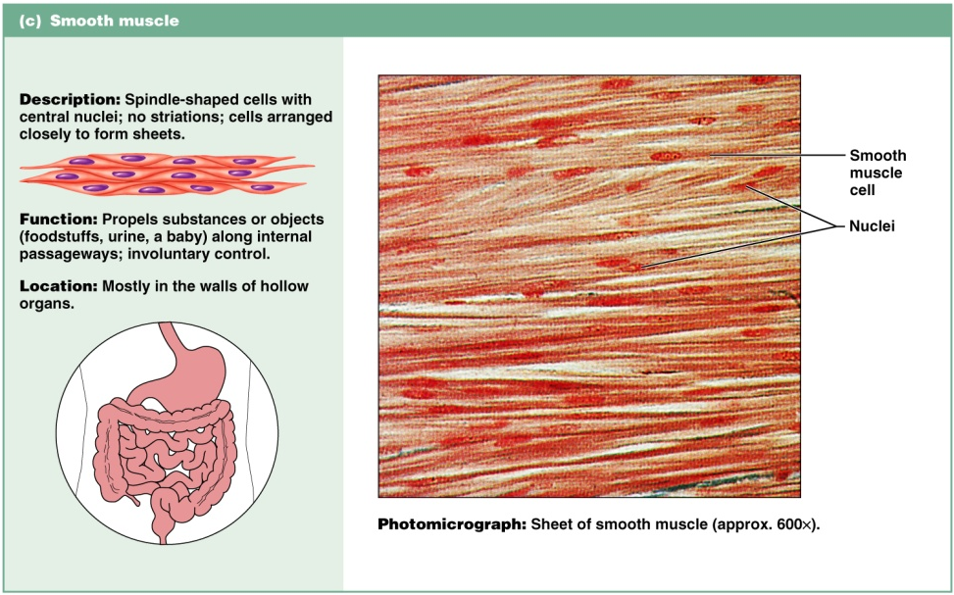
SMOOTH MUSCLE

Slide 22
SMOOTH MUSCLE
Non-striated (homogenous or haphazardly arranged). Filaments are not organized in order.
Involuntary innervation (ANS) and use; humoral control.
Found around blood vessels, gut, bronchi, bladder, eye, glands, etc. (visceral organs 🡪 not attached to skeleton)
Arrector pili muscle??? – in the skin to raise hair
Detrusor muscles??? – fibers within the urinary bladder
In some cases connected to the skeleton “rectococcygeus” – attach rectum to skeleton (coccygeus = vertebrate of the tail)

Slide 23
CARDIAC MUSCLE

Slide 24
CARDIAC MUSCLE
Striated 🡪 organized fibers
Involuntary innervation and use.
Joined at intercalated disc
Limited to myocardium (heart) and base of great vessels.
Generates its own contractions autonomously, & regulate the frequency of contractions rhythmically. (doesn’t need nerve to beat)
Purkinje fibers: conducting of impulses

Slide 25
Myology
The end

